Slide 1
Converging Continents

Slide 2
Pre-Columbian Western Hemisphere
Where did the first Americans come from? How were the continents populated?
How did native Americans live? What regional variations are evident?
How did native American life change? What factors caused these changes?
Eastern Woodland tribes.

Slide 3
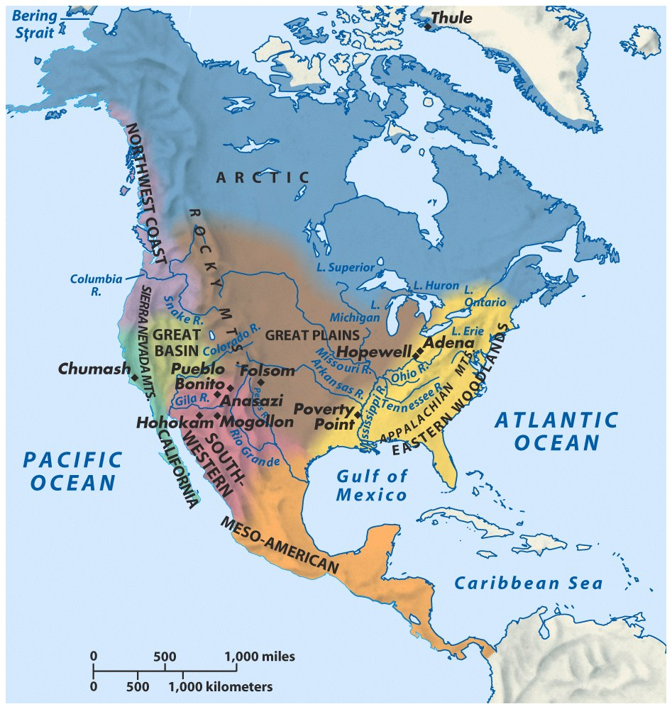
North America
Distinguish from South America
Impact on European colonization
Early contacts between natives and Europeans
Exploration
Cod fishery
Hidden holocaust

Slide 4
Pre-Columbian Eastern Hemisphere
Evaluate the concept of the “New World.”
What are the two significant aspects of the Reconquista?
How was the Eastern Hemisphere tied together prior to 1492?
How did European exploration impact Africa?
Why do we remember Christopher Columbus? How should he be remembered?

Slide 5
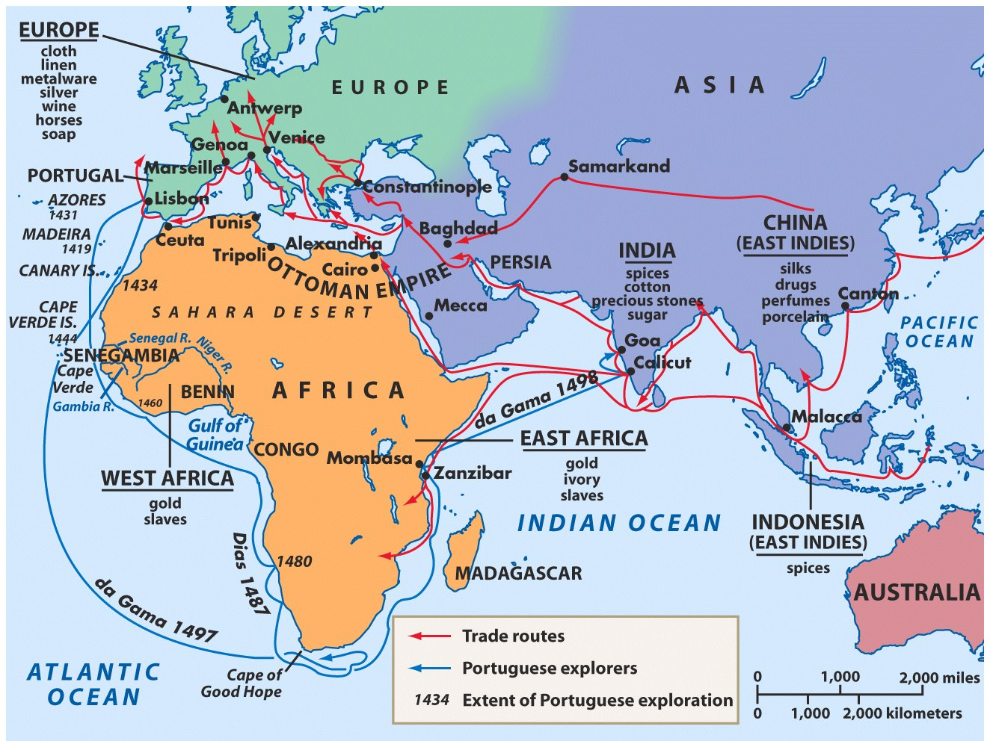
Silk Road Portuguese exploration

Slide 6
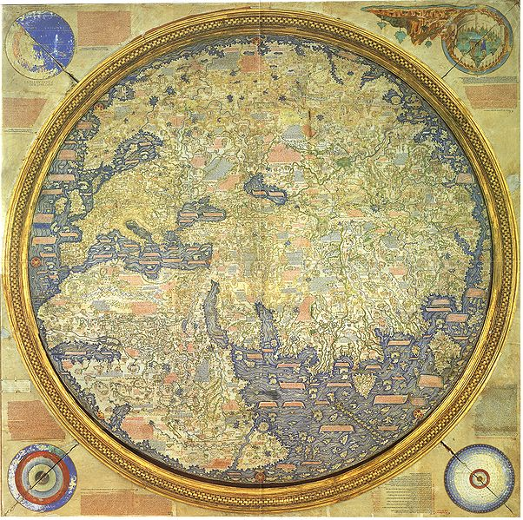
Fra Mauro Map (ca. 1459)

Slide 7
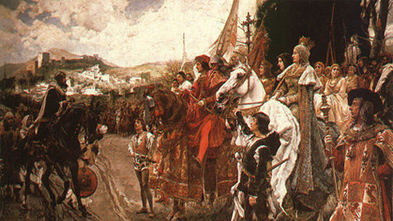
Reconquista
God
greed
glory

Slide 8
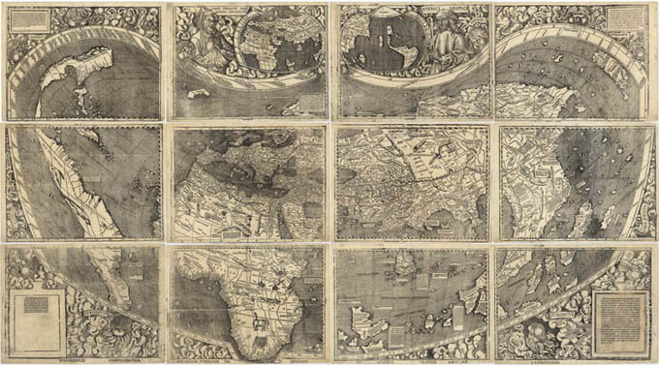
Waldseemüller Map (ca. 1507)

Slide 9
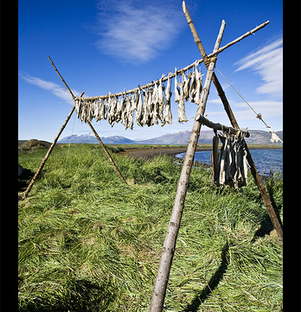
The Columbian Exchange
Disease
Animals
Food crops
Staple crops
Cod
Impact on:
America
Europe
Africa

